Slide 1
Can You Do API Testing With Cypress?

Slide 2
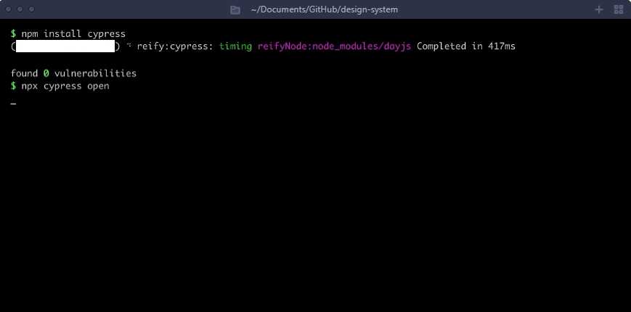
What can you do with Cypress?
Easy Installation
Learn more
Guided Setup
Readable Tests

Slide 3
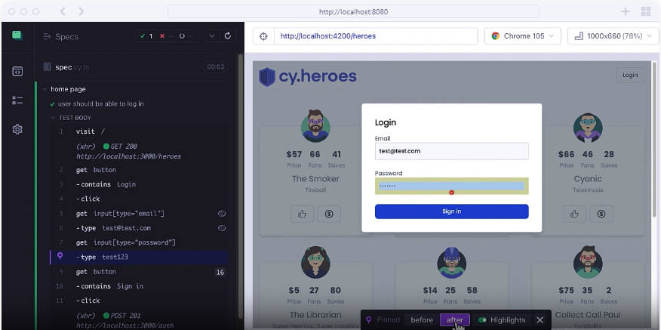
What can you do with Cypress?
Time Travel
Live Reload
Native Browser Inspection
Screenshots & Videos

Slide 4
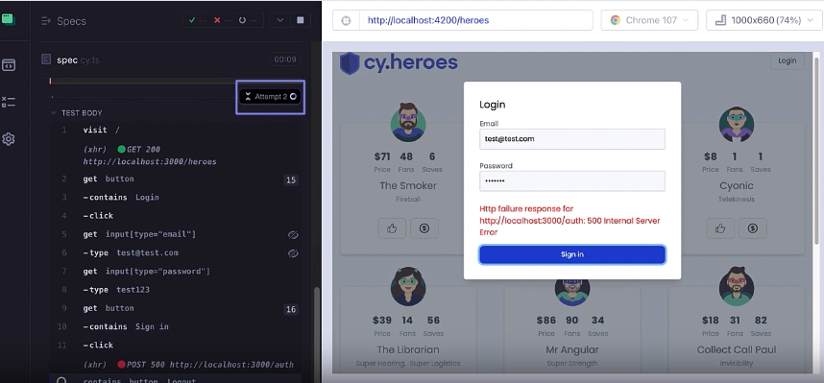
What can you do with Cypress?
Eliminate flakcy tests
Automatic Waiting
Test Retries
Test Isolation
Flake Detection
Consistent Results

Slide 5
What can you do with Cypress?
Eliminate flakcy tests
Automatic Waiting
Test Retries
Test Isolation
Flake Detection
Consistent Results

Slide 6


What tools do you use for API testing? Is it better to have one tools that can do e2e, API?

Slide 7


Write first API test with Cypress

Slide 8
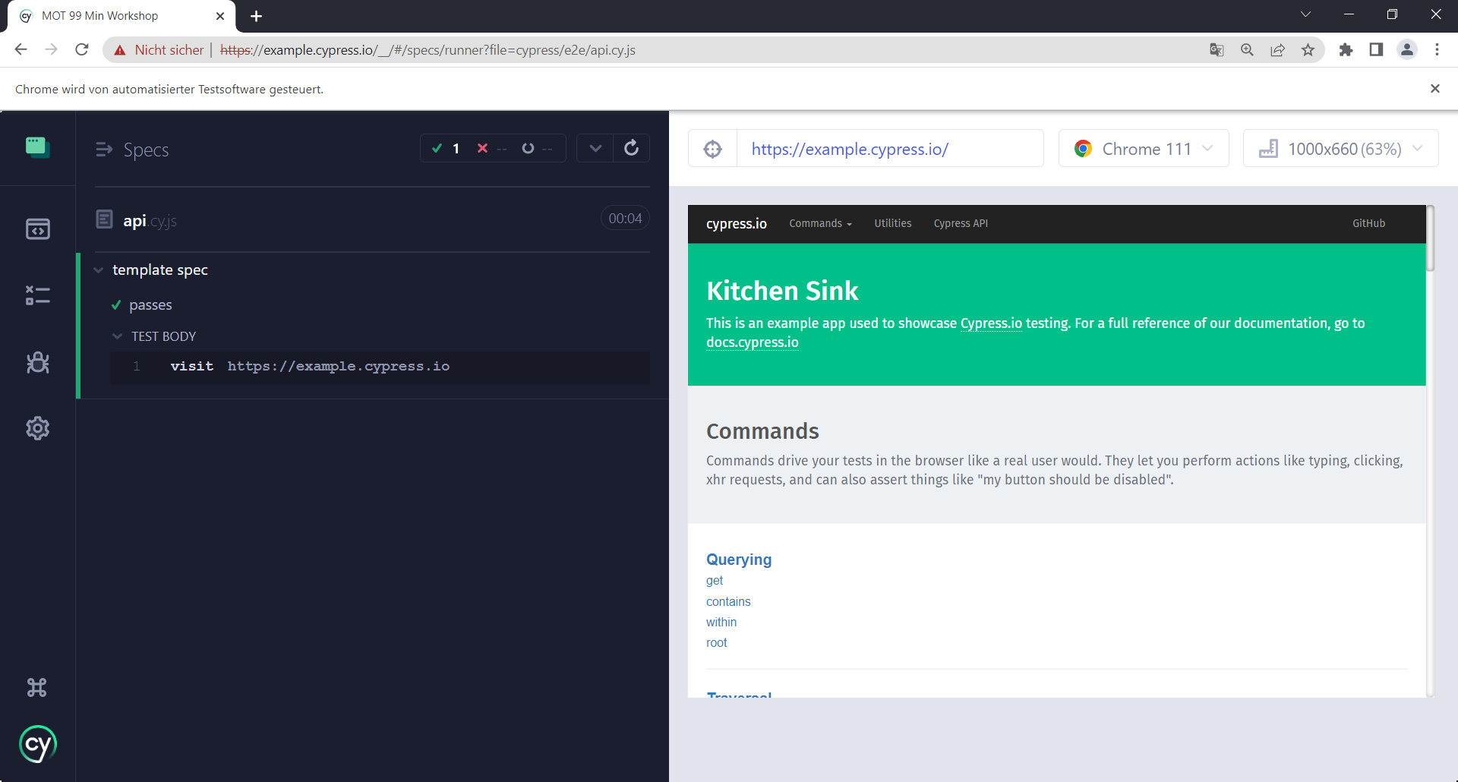
Really easy installation
New Folder
Npm init
Npm install cypress
Npx cypress open
A touch of configuration

Slide 9
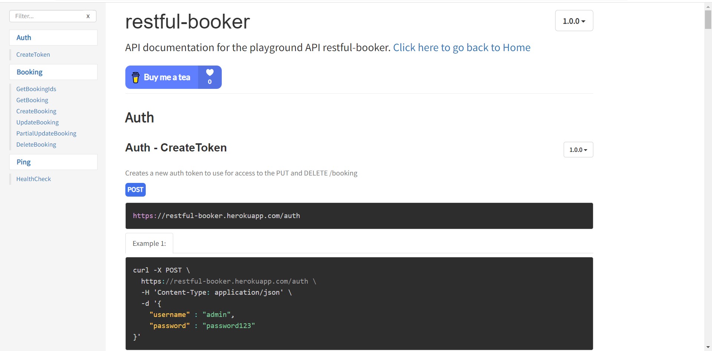
How to do API checks in Cypress
API to test
https://restful-booker.herokuapp.com/apidoc/index.html

Slide 10

Discussion
What API checks do you do?
What should we test?
Can we do those with Cypress?
https://juliapottinger.com/api-testing-checklist/

Slide 11
API Checks
Documentation
Response Codes
Response Body
Error Handling
Schema match
https://juliapottinger.com/api-testing-checklist/

Slide 12
API Checks
Simple form
Extended form
cy.request('https://restful-booker.herokuapp.com/booking')
cy.request({
method: 'POST',
url: 'https://restfulbooker.herokuapp.com/booking',
failOnStatusCode: false,
body: }).as('booking')
//Validate status code
cy.get('@booking').its('status').should('eq', 200)
cy.get('@booking').then((response) => {
cy.log(JSON.stringify(response.body))
})

Slide 13

Make things a bit more easy
How can we improve on what Cypress offers
Are there any things we did badly?

Slide 14
To improve
See the results
Dynamic data

Slide 15

Use Dynamic data
Fixtures

Slide 16
See the data
Plugin
npm i cypress-plugin-api
Import the plugin into your cypress/support/e2e.js file:
import 'cypress-plugin-api’
https://filiphric.com/cypress-basics-api-testing

Slide 17
What have we learned
How to Install Cypress
How to make API tests in Cypress
How to install API plugin
Make tests dynamic
Make API checks

Slide 18

Thank you and for your time

